Slide 1






Ethical Behaviour

Slide 2
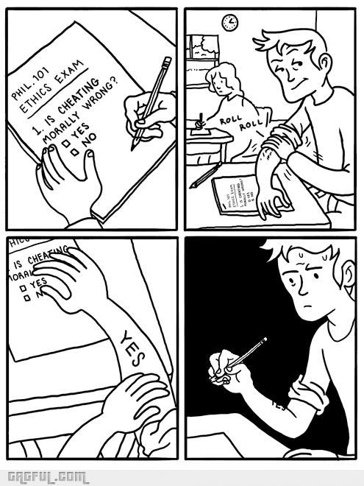

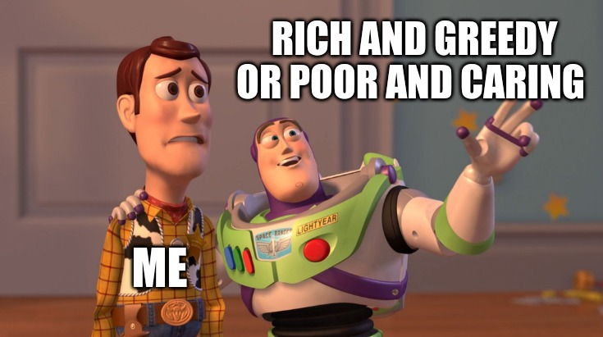

Slide 3
What are Ethics/Morals Again?
What is Right/Wrong
Moral Compass
I’m in a dilemma! 😳
Society’s “Unwritten Rules”
Empathy
“
Ethics are not definable, are not implementable, because they are not conscious; they involve not only our thinking, but also our feeling.
Valdemar W Setzer
”

Slide 4
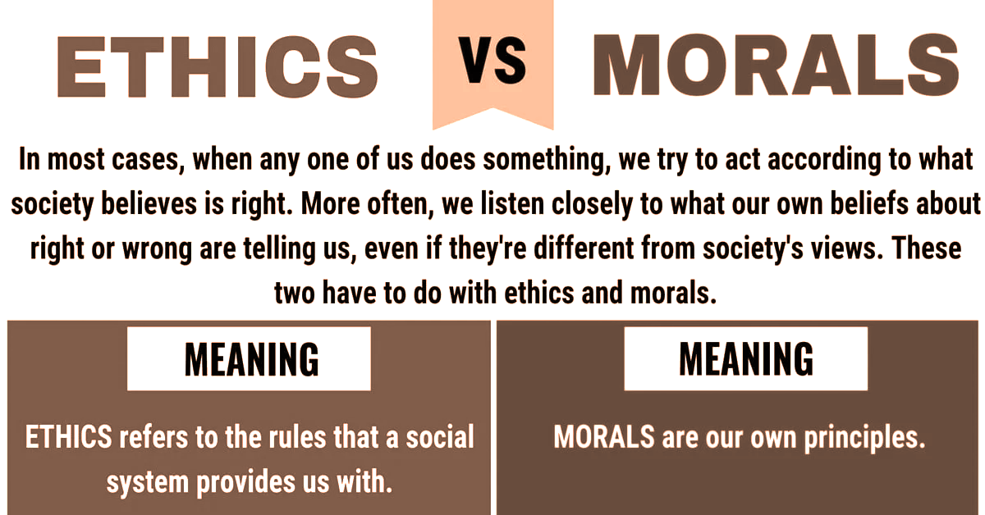

Slide 5

Would You Steal Bread to Feed Your Family?💰👨‍👩‍👧‍👦🍞..

Slide 6
The Trolley Problem
🚋 🧐

Slide 7

TW: graphic/dark humor

Slide 8

TW: graphic/dark humor, blood

Slide 9
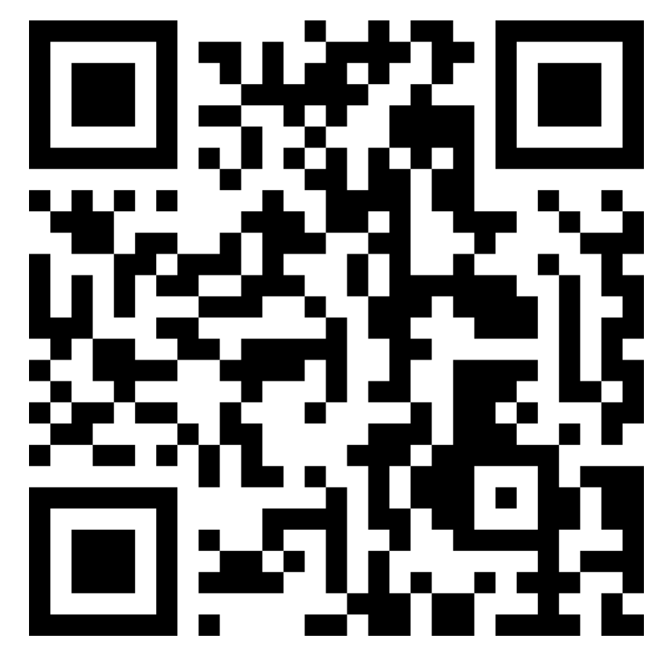
So, what does this have to do with relationships?
https://www.mentimeter.com/app/presentation/alagv1mh8nofp4d3txn1e8rh19c27h92
www.menti.com 7522 8335

Slide 10
Next class: More case studies!
Honesty
Loyalty
01
03
Consistency
Compassion
02
04
(omitting the truth = lying?)
We will be writing our own.
Here are some decision making examples:
You’re trying to get insta-famous, but you don’t like how you look anymore. You keep posting selfies from 2-3 years ago. It’s still you, but doesn’t look like how you are currently. Your best friend doesn’t say anything and you’re getting more likes than ever.
Should you keep doing it?
Your partner has communicated to you that they are not seeing anyone else. You are indecisive and do not want to commit to only one person yet. You choose to keep exploring options (seeing other people) without telling them, because you don’t want to hurt their feelings. Is this right or wrong?
You promised your friend that you would walk home with them after school every day, but your crush is now asking to hang out with you at that time. What should you do?
Your dog recently passed away. As your friend has always been a cat person, they find it hard to understand the emotional connection you had to your dog. After hearing the news, they apologize, then go on about a funny thing their cat did this morning, showing pictures/videos. They did share condolences, so was this ethical?

Slide 11
Next class: More case studies!
Reasonableness
Justice/Fairness
05
07
Forgiveness
Trust
06
08
Examples cont.
Your partner stopped replying to your texts suddenly, in the middle of an important conversation. Should you assume that they are ignoring you and don’t like you anymore? Or maybe they got busy or their phone died? Think before you act.
Your parents are making you go to an important last minute family event, but your friend/partner invited you to a party weeks ago that you said you would be at. They are on the same night. Do you let down your family or your friend/partner?
Your friend/partner confides in you about their mental health and you believe they may be at risk for harming themselves. They opened up to you only on the terms that you would not share anything about the conversation. What should you do if you don’t want to break their trust?
Your partner has cancelled on your plans three times now. They keep apologizing, and promising change, but nothing happens. You really like everything else about them and they usually make you happy. How long do you keep forgiving them if their behaviour stays the same?

Slide 12
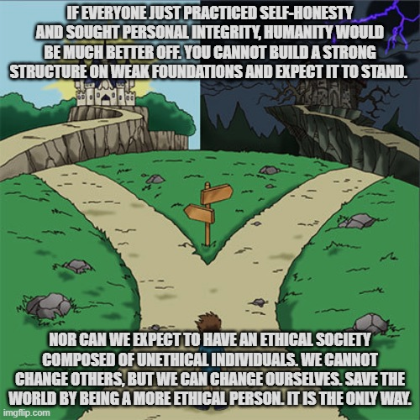

Slide 13


Slide 14
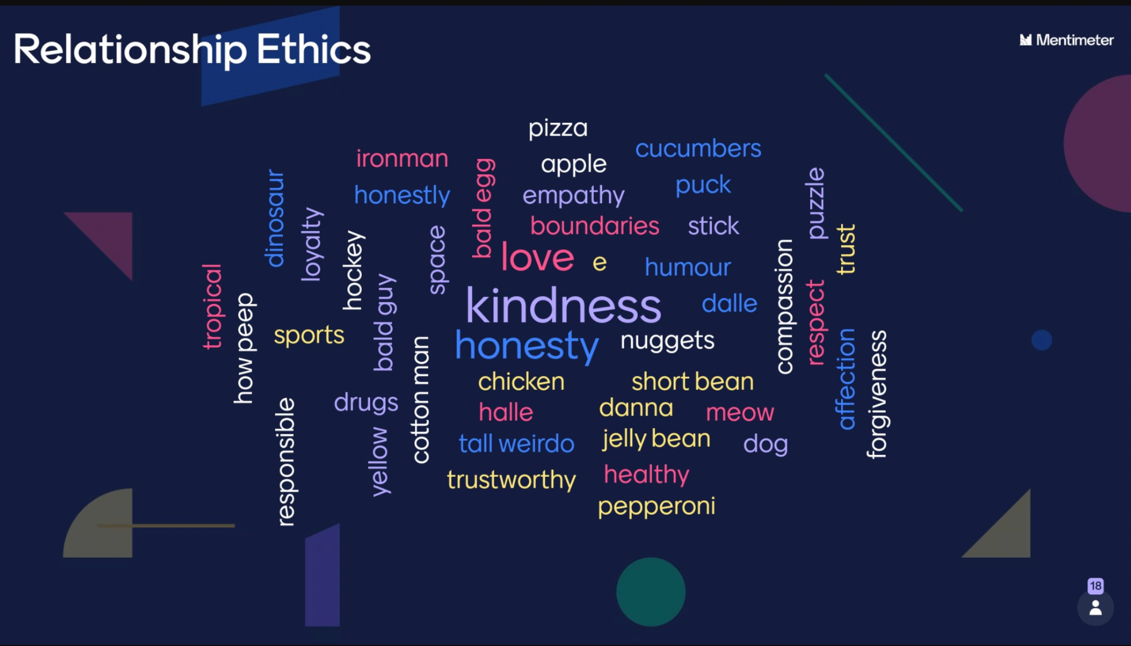
- 8E

